Slide 1



Combined GPS and Intensity-based Alignment of Laser Devices
Track Tech
Members: Dawson Burgess, Marissa Samayoa, Spencer Butler

Slide 2

Table of Contents
Objective
Value Proposition
Background
Laser Data Transfer
Hansen Photonics
Product Requirements
Key Attributes
Drawings
Bill of Materials
Manufacturing Plan
Validation Approach
Schedule
Budget
Potential Risks
Physical Demonstration

Slide 3
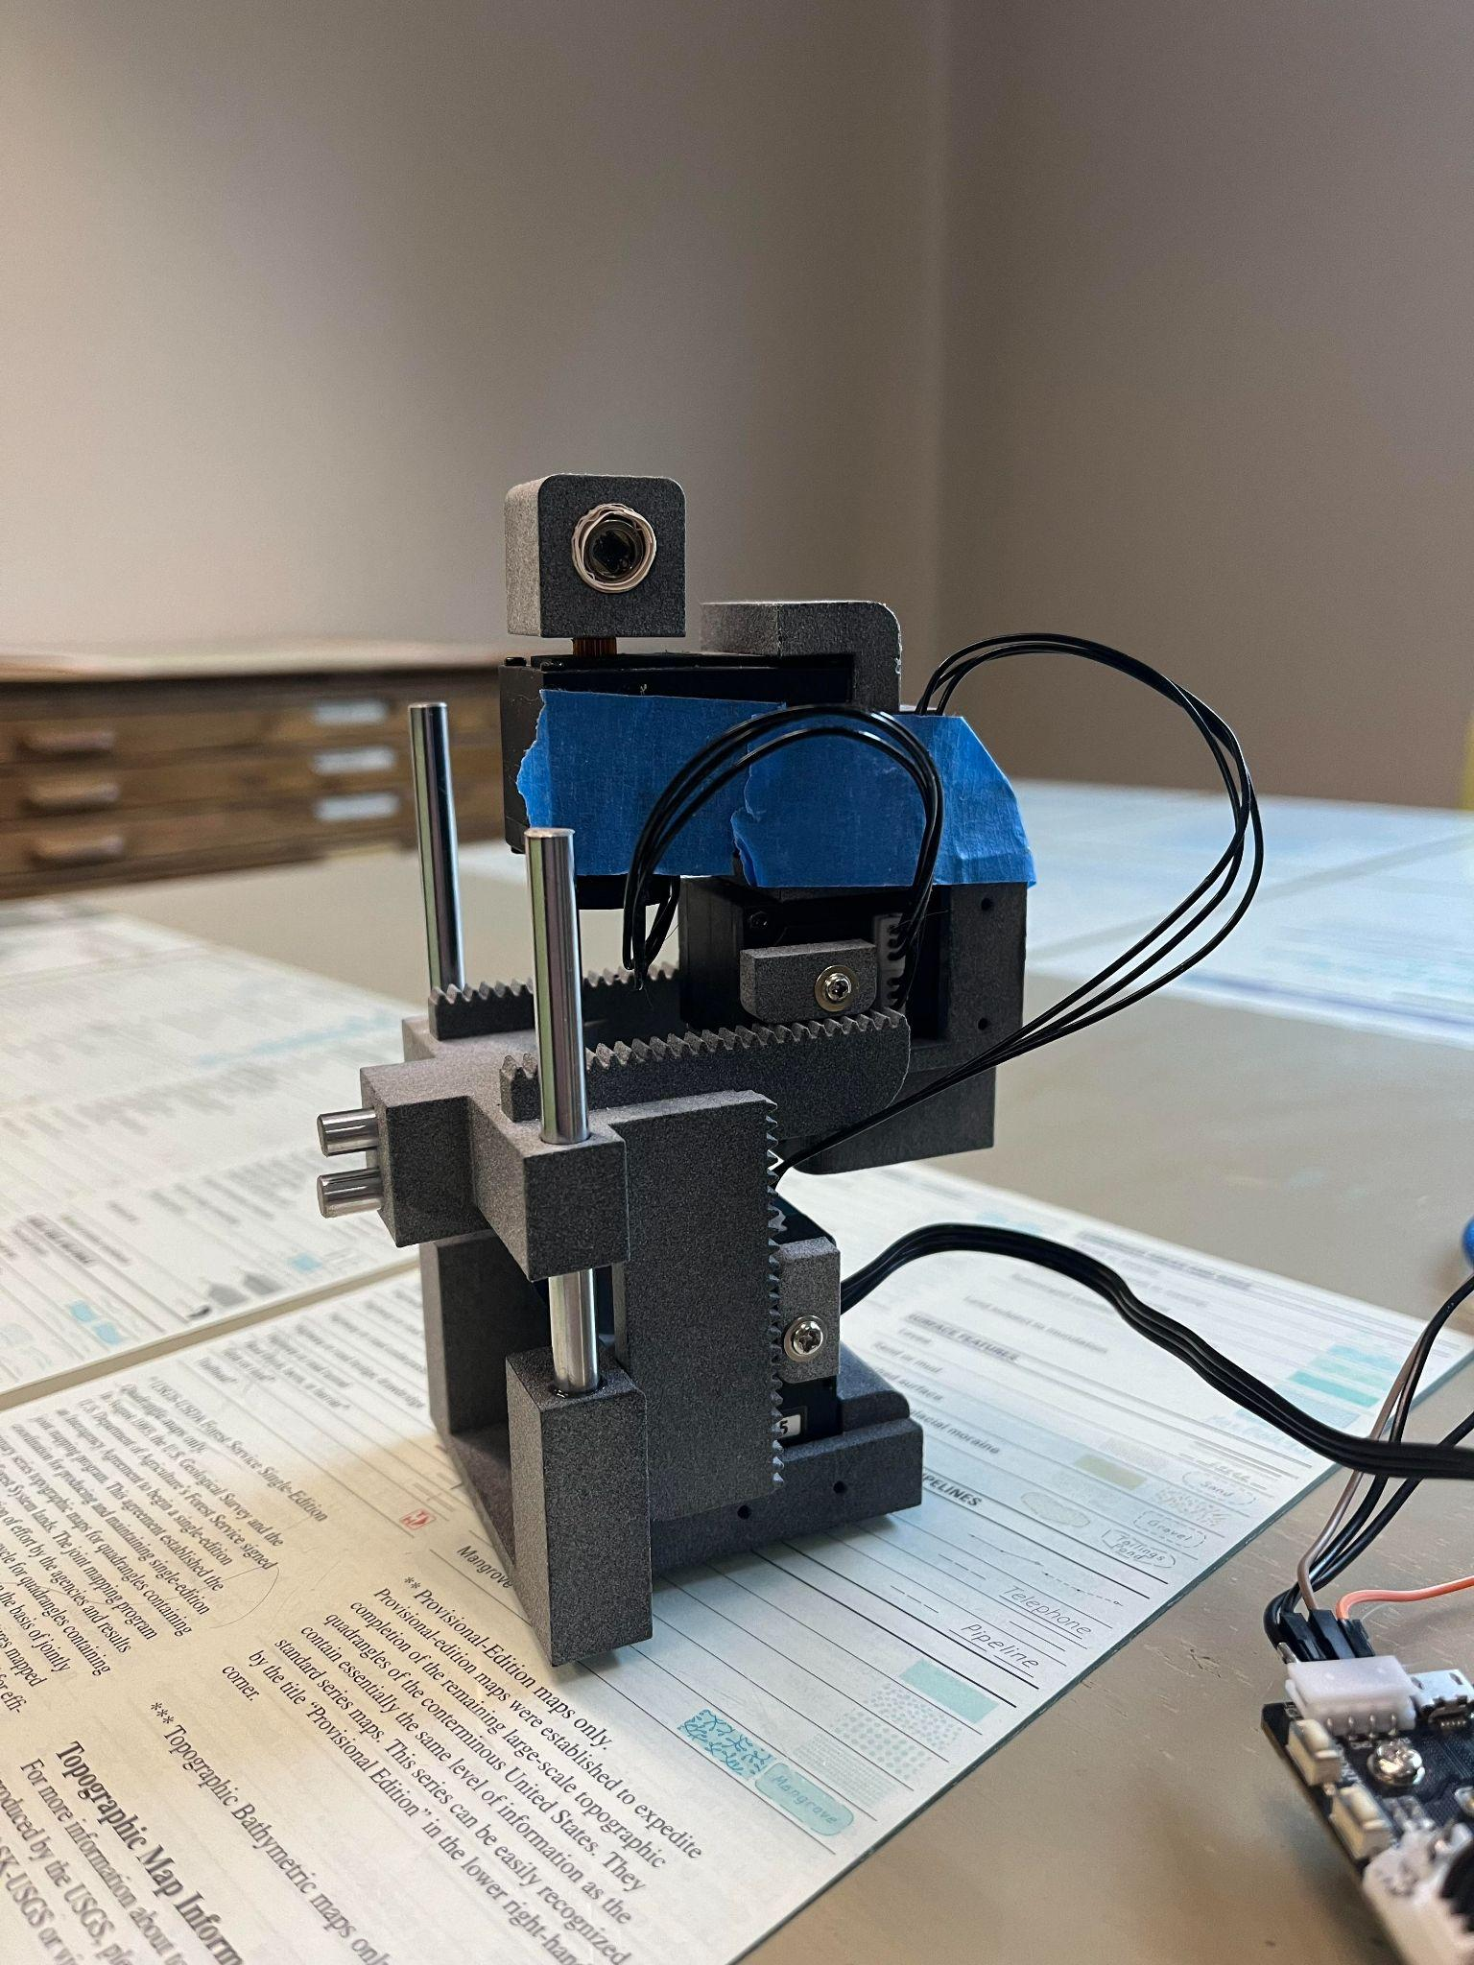
Objective
To implement and test embedded software to drive a robotic arm for optical beam alignment between two devices.
We will be implementing the rough alignment software that will then utilize minor adjustment software in the future.

Slide 4
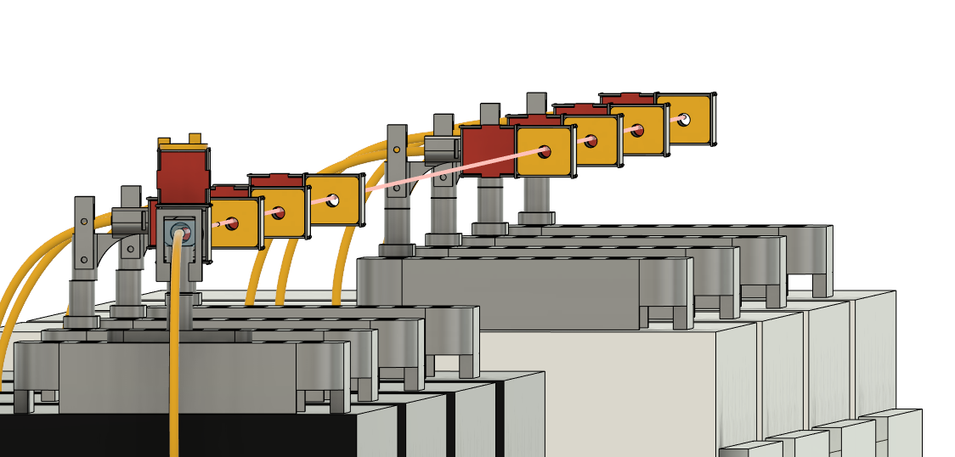
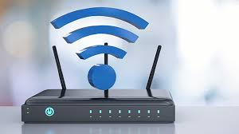
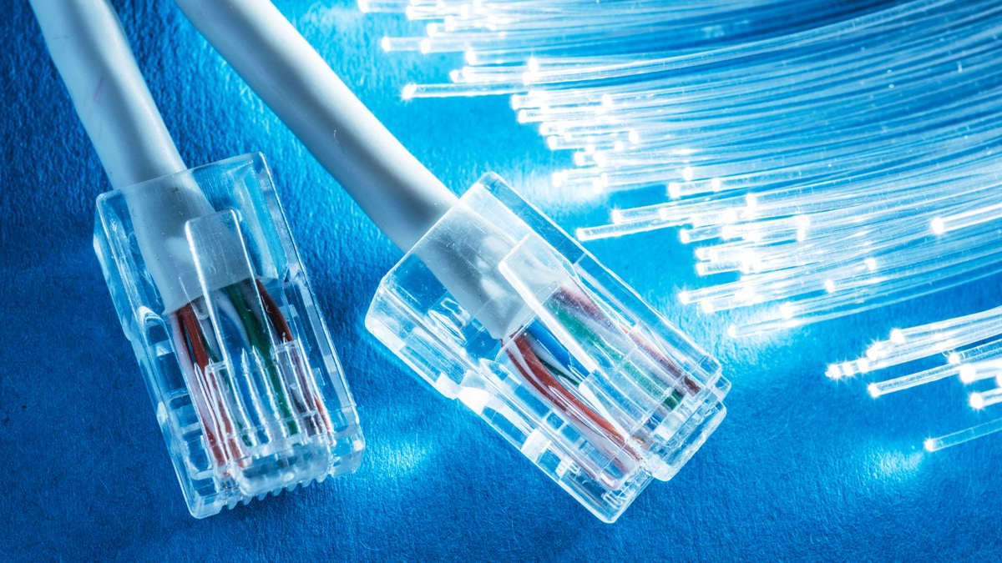
Value Proposition
Optical transfer allows for far greater transfer capacity than using electricity.
It can be implemented in a cost effective, yet environmentally friendly way via lasers.
Laser data transfer requires very precise alignment between two devices, and often takes hours of labor to establish a single connection.
We will design software which utilizes GPS that enables the devices to align and form a connection with a single button press.

Slide 5
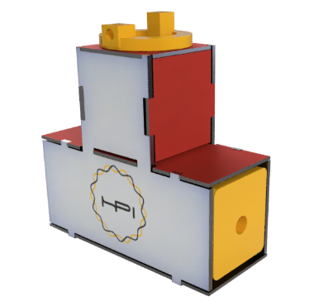
Background - Laser Data Transfer
Fiber and network cables are fast and secure, but often expensive, and require physical connections.
Wifi has no cables and can be fast, but struggles with security vulnerabilities and has a hard cap on transfer speeds.
Our technology will look to take the best of both implementations without their drawbacks.

Slide 6
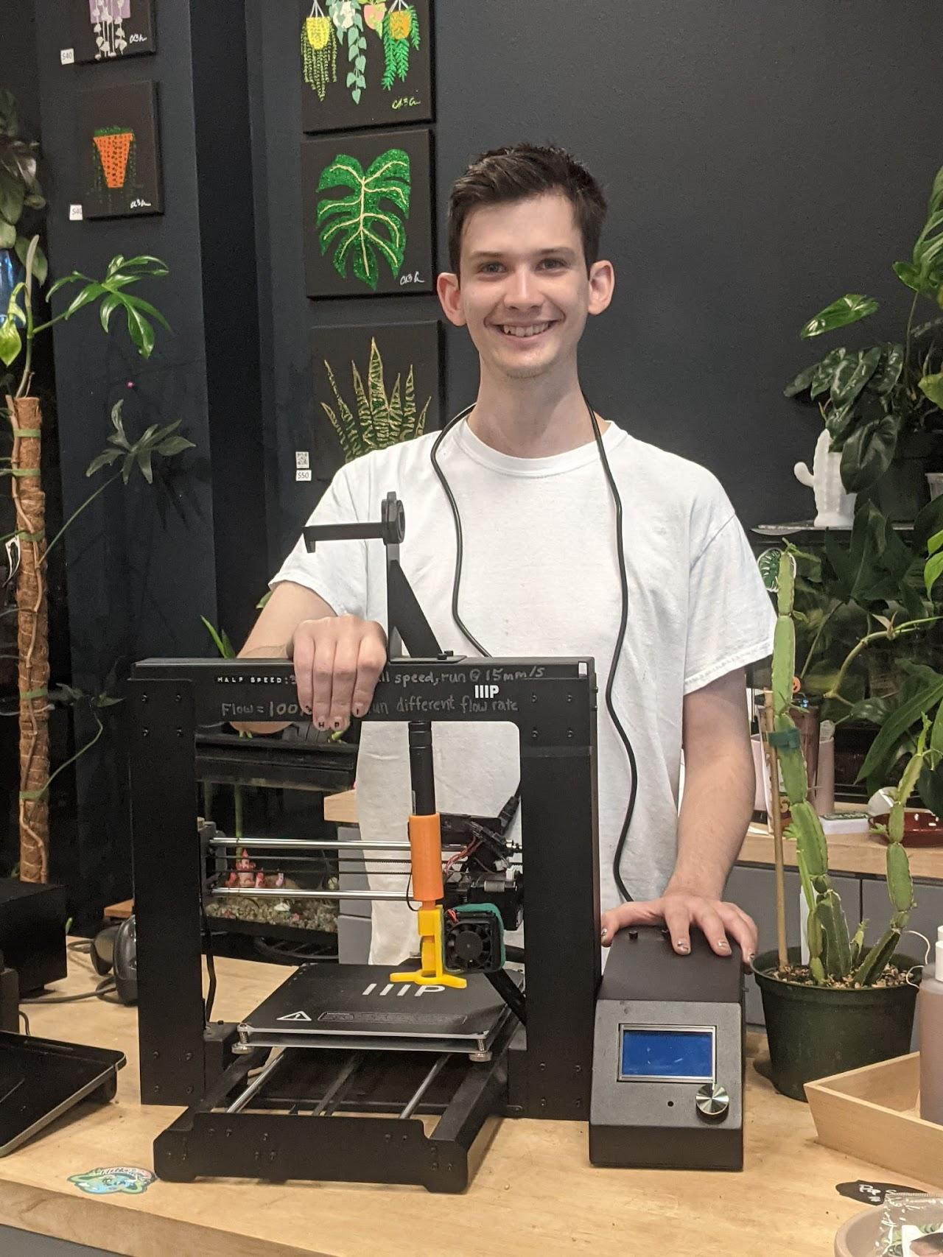
Background - Hansen Photonics
Hansen Photonics Incorporated is a small, family company located in Burien, Washington.
They contribute to the computer networking industry with patents that cover modular networking hardware devices and systems.
HPI works with universities, environmental science centers, and small businesses to help provide new, cutting-edge hardware solutions for everyone.

Slide 7
Product Requirements
01
This alignment process shall work at a minimum distance of 6 feet.
02
After beginning the program, the alignment process shall be fully automatic.
03
The devices shall weigh fewer than 10 lbs each.
04
The program shall be written in a modular style.
Notes:
1-7

Slide 8
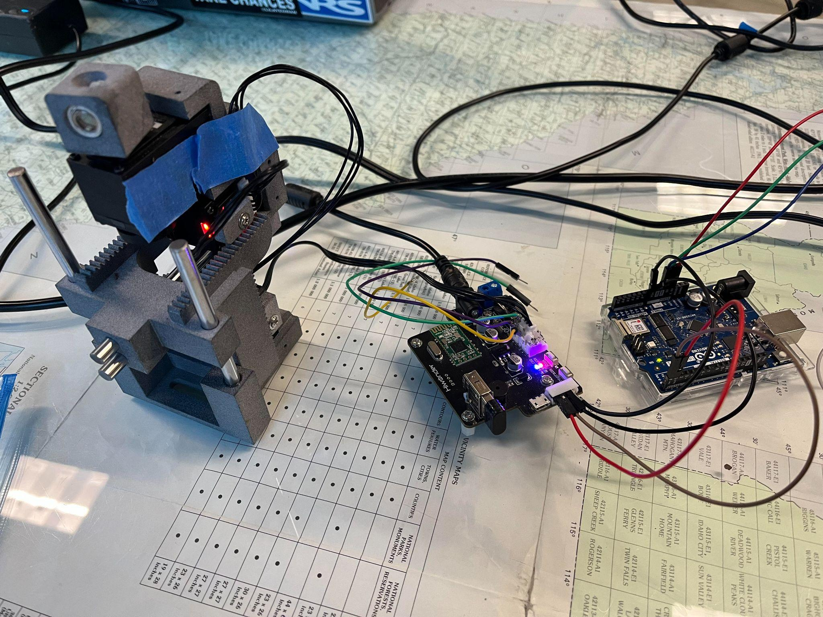
Key Attributes
Big Picture Idea
Breakdown of individual units and systems
Breakdown of Code
Wiring Diagrams

Slide 9
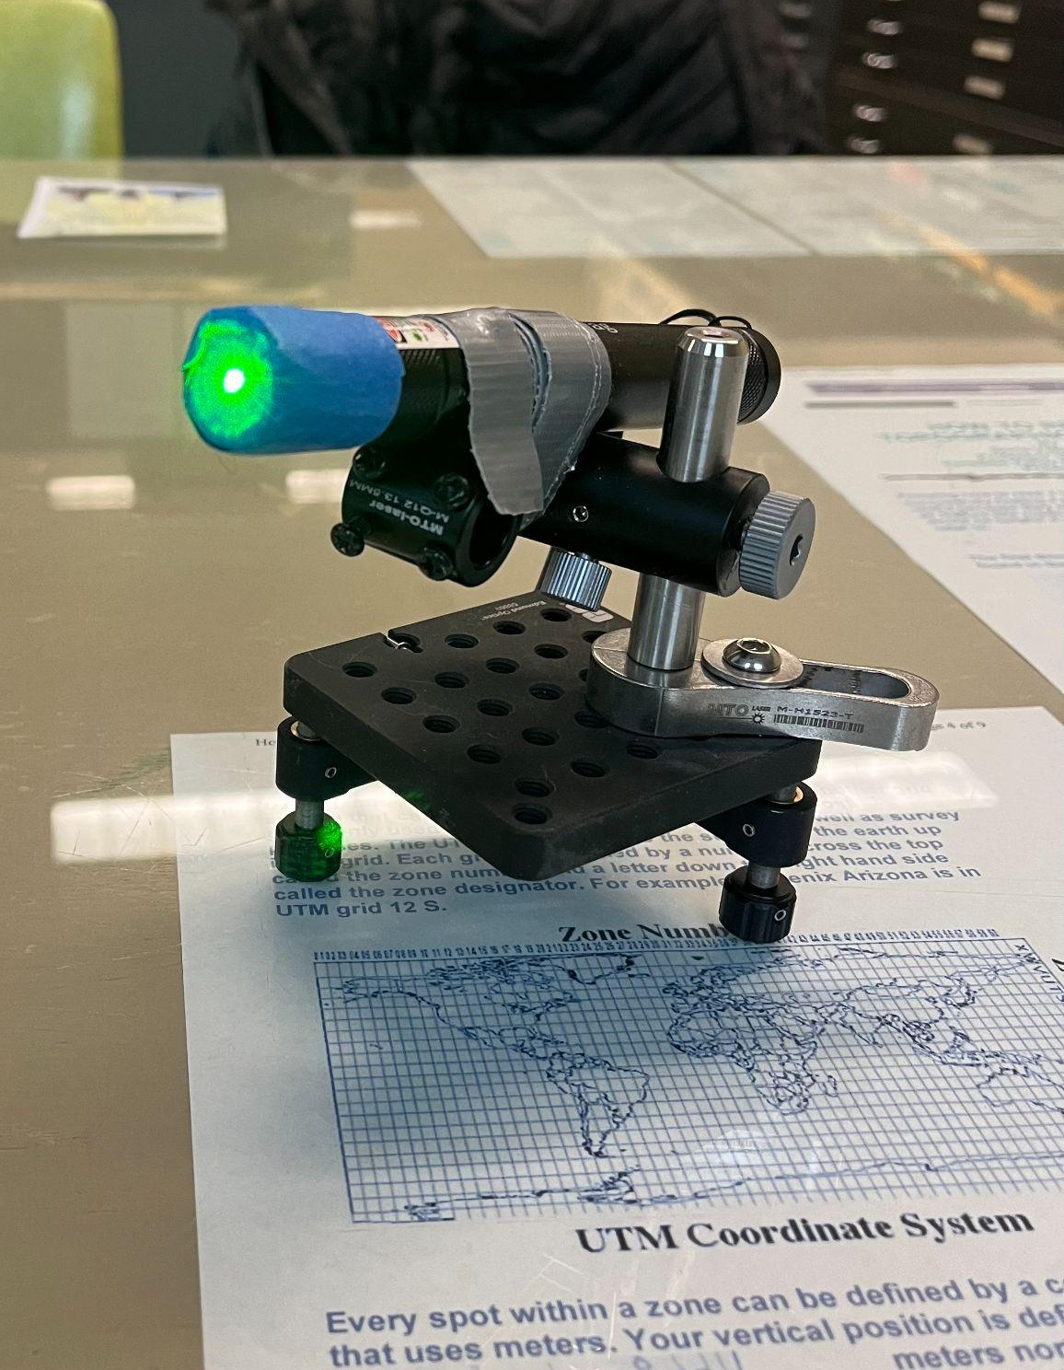
Big Picture
We will be using the GPS modules and accelerometers to get the positional data of the robot and the laser. This will allow us to pivot the robot to look in the direction of the sensor, then line up the sensor and laser for maximum signal strength.
Notes:
Dawson 8 - 23

Slide 10
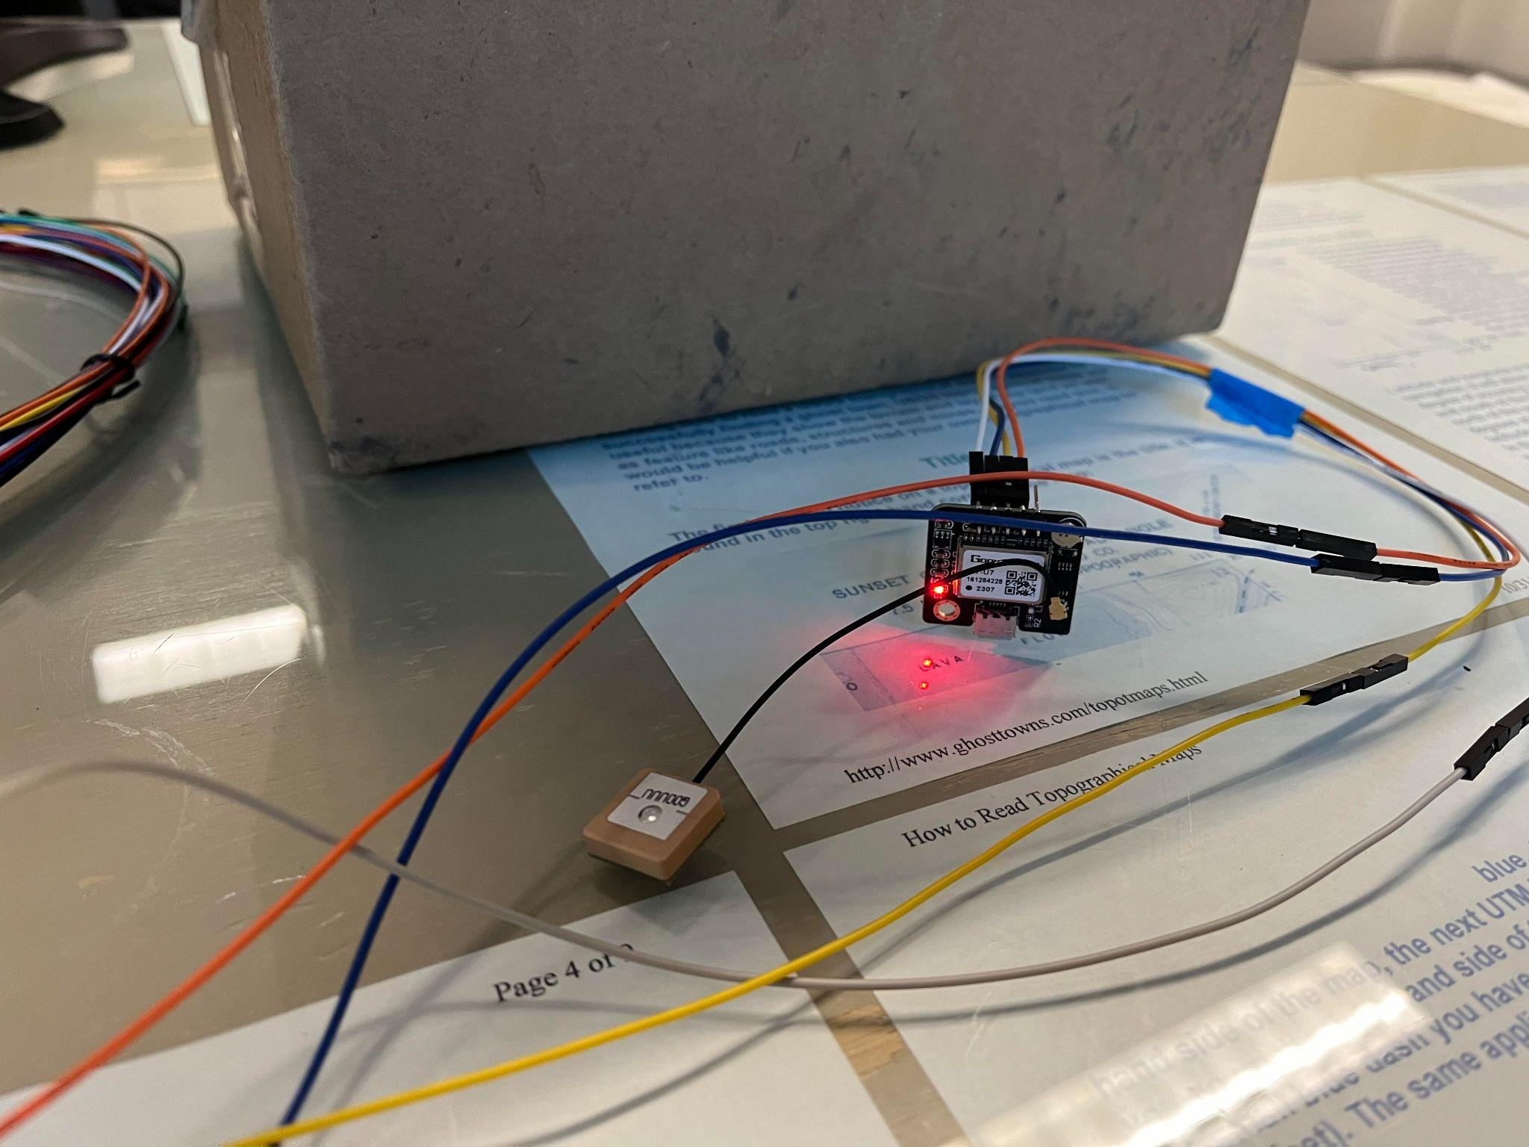
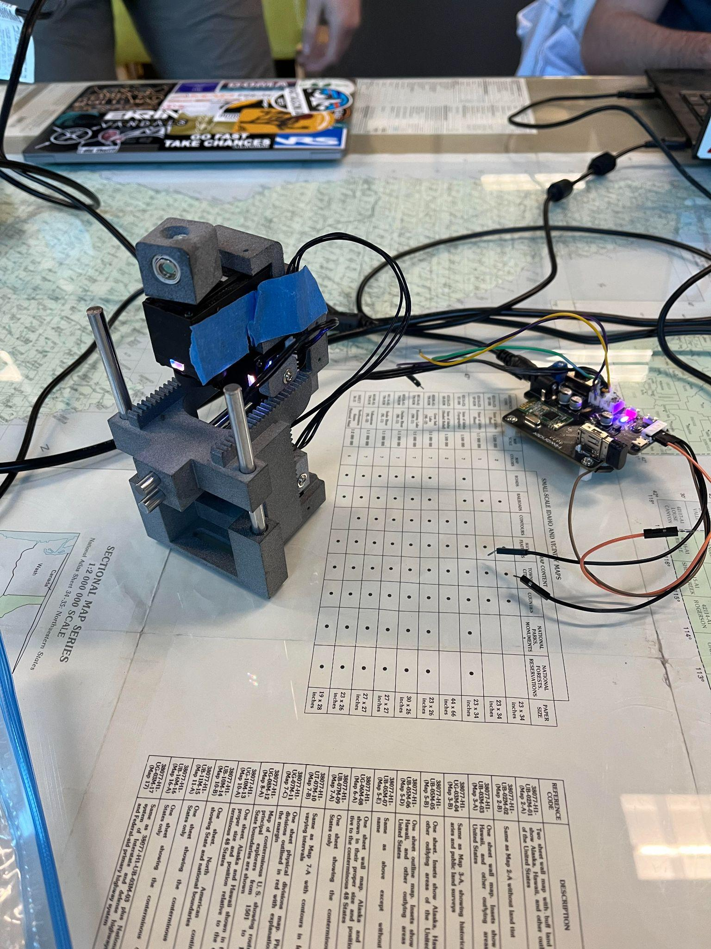
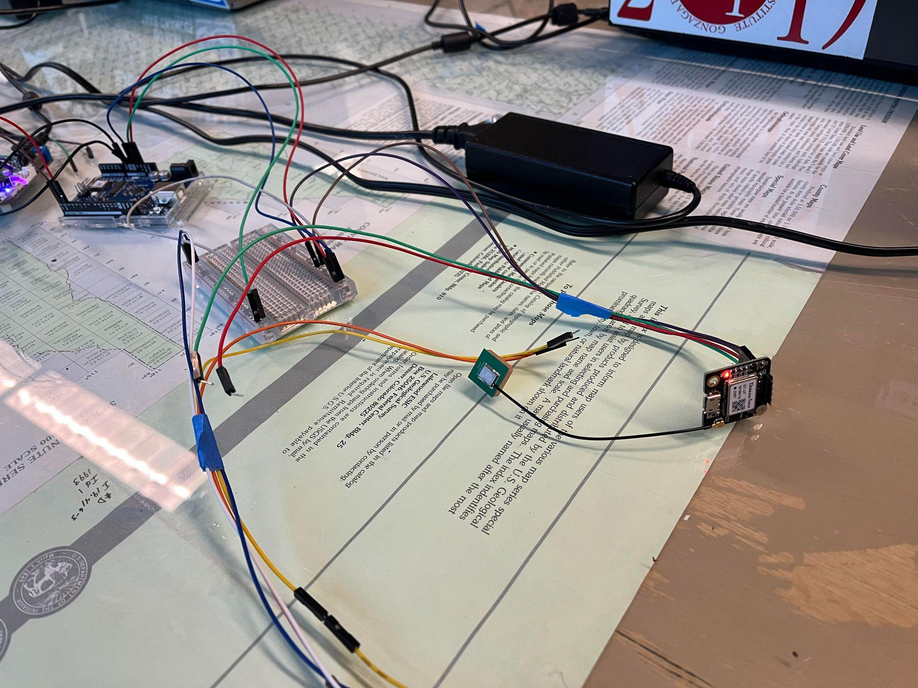
Description of Parts
GPS that will attach to laser
Robot and its board
GPS that will attach to robot
Laser device

Slide 11

GPS and Accelerometer
We will be using the GPS and accelerometers to get positional data from the laser and the robot.
This will help us to get the robot to look in the right direction, as well as make sure the laser is in an appropriate range.
The blinking light means we have a fix on the satellites.

Slide 12
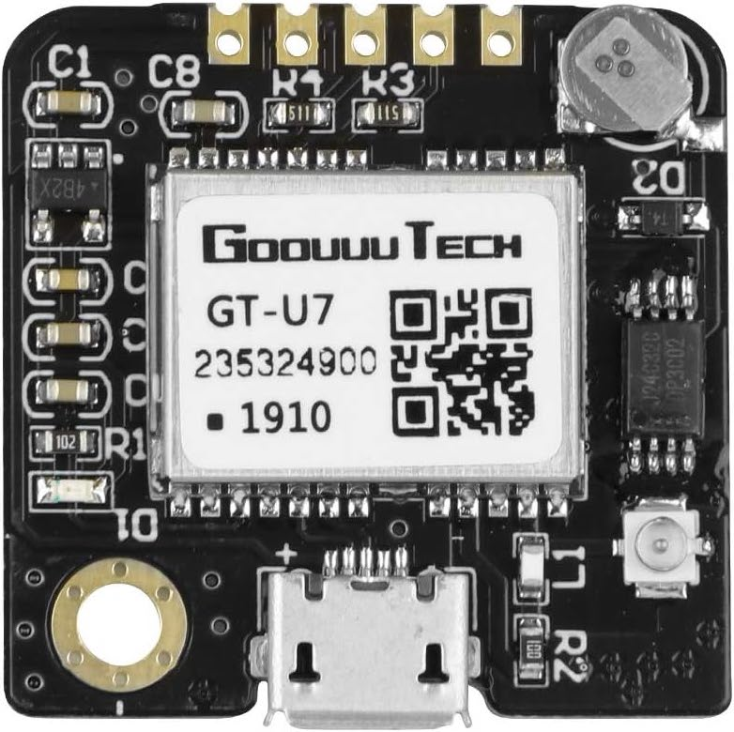
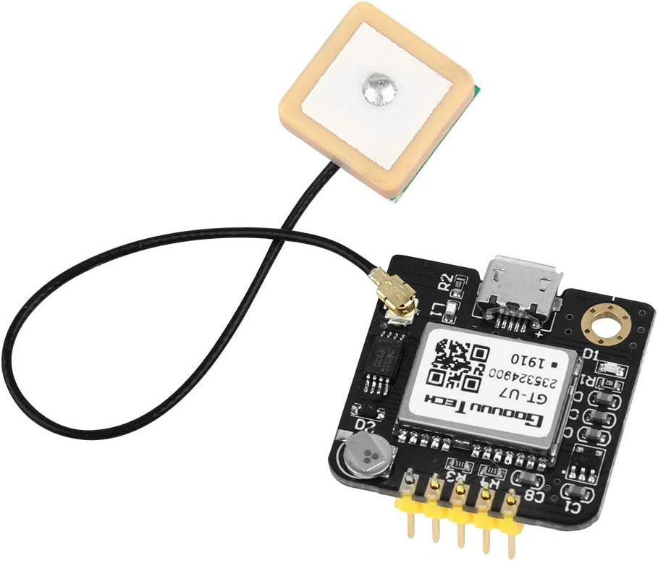
GPS Data Description
The two types of GPS data we receive most from GT-U7 GPS device are of the following protocols: $GPGGA and $GPRMC.
$GPGGA: This log contains time, position and fix related data of the GNSS receiver. The GPGGA log outputs these messages without waiting for a valid almanac. Instead, it uses a UTC time, calculated with default parameters. In this case, the UTC time status is set to WARNING since it may not be one hundred percent accurate. When a valid almanac is available, the receiver uses the real parameters. Then the UTC time status is set to VALID.
$GPRMC: This log contains time, date, position, track made good and speed data provided by the GPS navigation receiver.

Slide 13
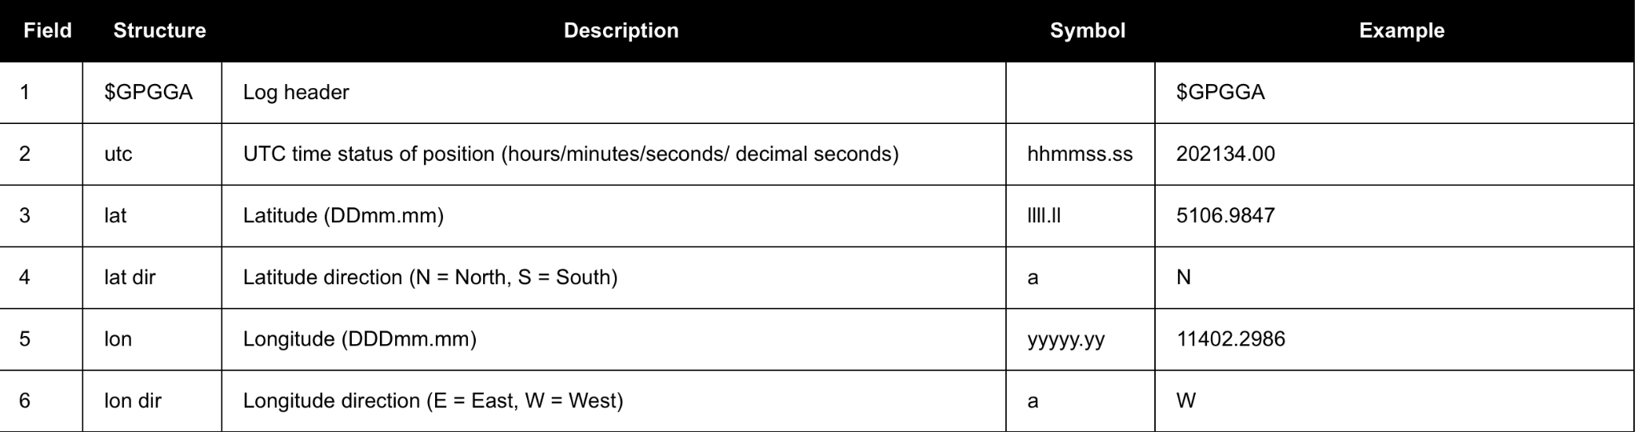
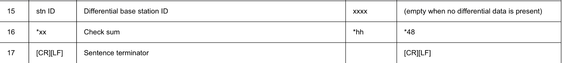
GPS Data Description: $GPGGA
Example Data Point: $GPGGA,202530.00,5109.0262,N,11401.8407,W,5,40,0.5,1097.36,M,-17.00,M,18,TSTR*61
Notes:
1-7

Slide 14
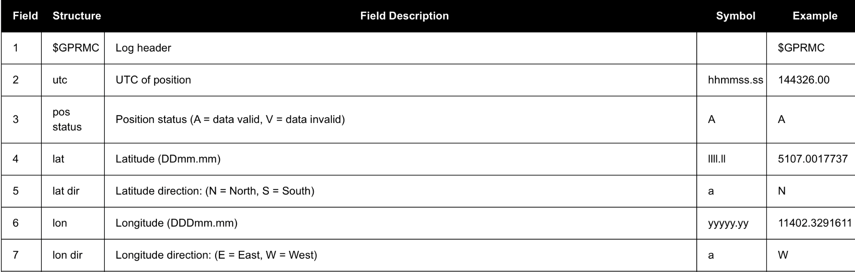
GPS Data Description: $GPRMC
Example Data Point: $GPRMC,203522.00,A,5109.0262308,N,11401.8407342,W,0.004,133.4,130522,0.0,E,D*2B

Slide 15
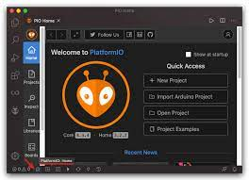
Breakdown of Code
Overview:
A big picture overview of what TinyGPSPlus is and what is has to offer.
Then we will showcase some of the functions we will be using in our code.
A big picture view of xArmServoController library.
Showcasing how it works and the functions we will make use of.
Then we will take a look at some snippets of important sections of our code and what's to come.
Some of the new tools we have implemented for building and compiling, etc.

Slide 16

TinyGps++ Library
This library is compatible with all architectures, so you should be able to use it on all the Arduino boards.
Like its predecessor, TinyGPS, this library provides compact and easy-to-use methods for extracting position, date, time, altitude, speed, and course from consumer GPS devices.
TinyGPSPlus’s programmer interface is considerably simpler to use than TinyGPS, and the new library can extract arbitrary data from any of the myriad NMEA sentences out there, even proprietary ones.

Slide 17
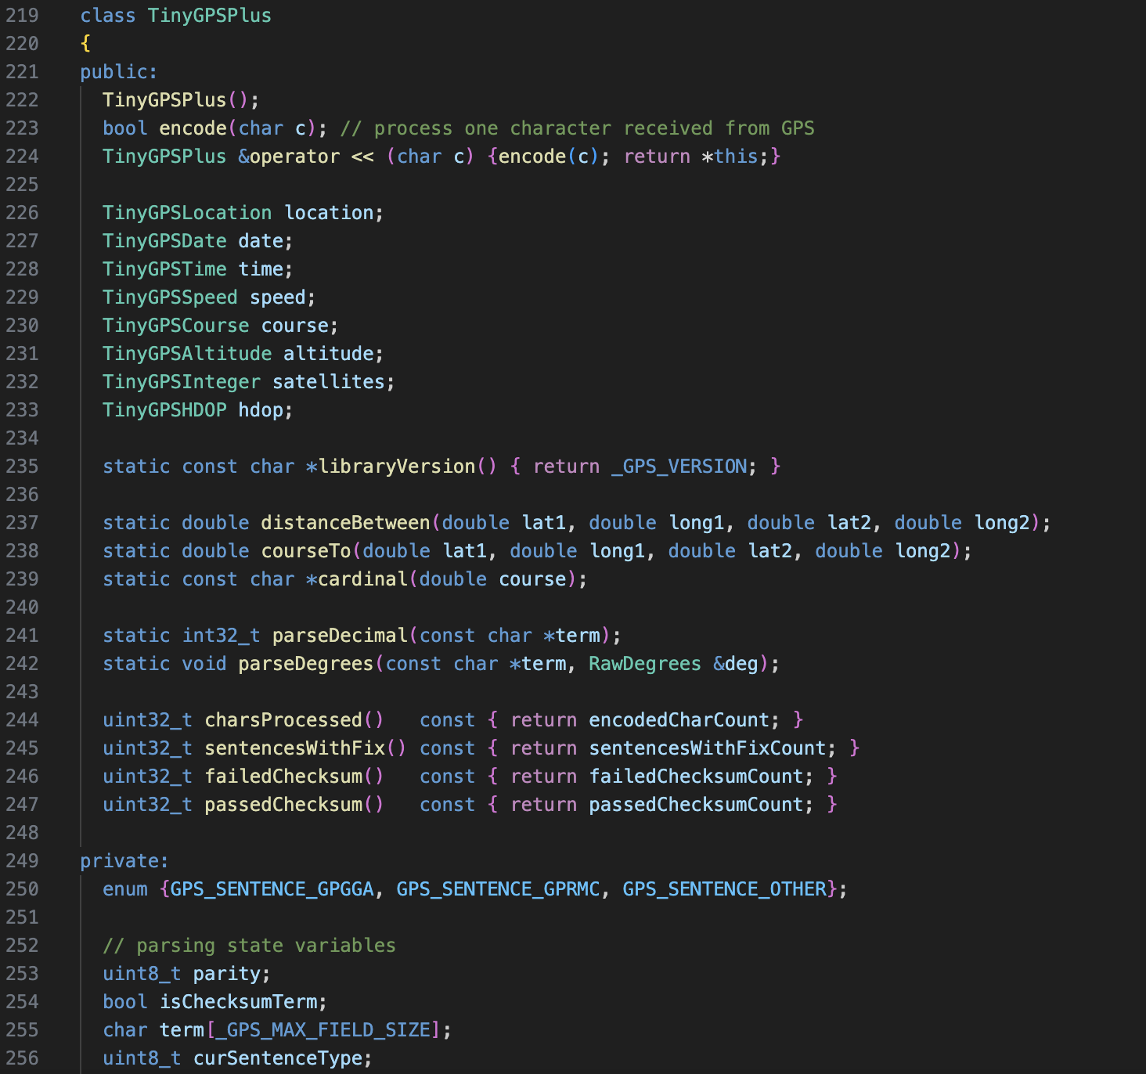
TinyGps++ Library
An overview of the class definition for what we will be using to receive and translate GPS data - the TinyGPSPlus class.
The main component that we will be using from this library is the encode() function.
This library consists of many friend classes that are also used in conjunction with what we need.

Slide 18
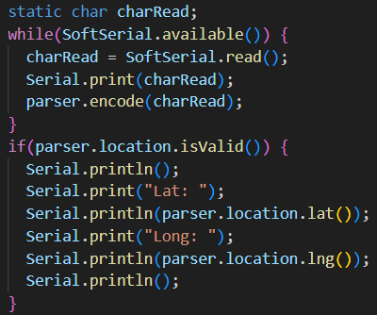
Our Code: Handling GPS Data
Here’s a look at some of the code we have to handle getting and parsing GPS data:
First we make sure software serial is working
Next we have a static char read in what's being sent to software serial
For testing purposes, we also have a print function to make sure things are in order
Next we have TinyGPSPlus call the encode() function
Lastly, if the positional data is valid, we have it printed. In the future we will have this sent directly to the robot.

Slide 19
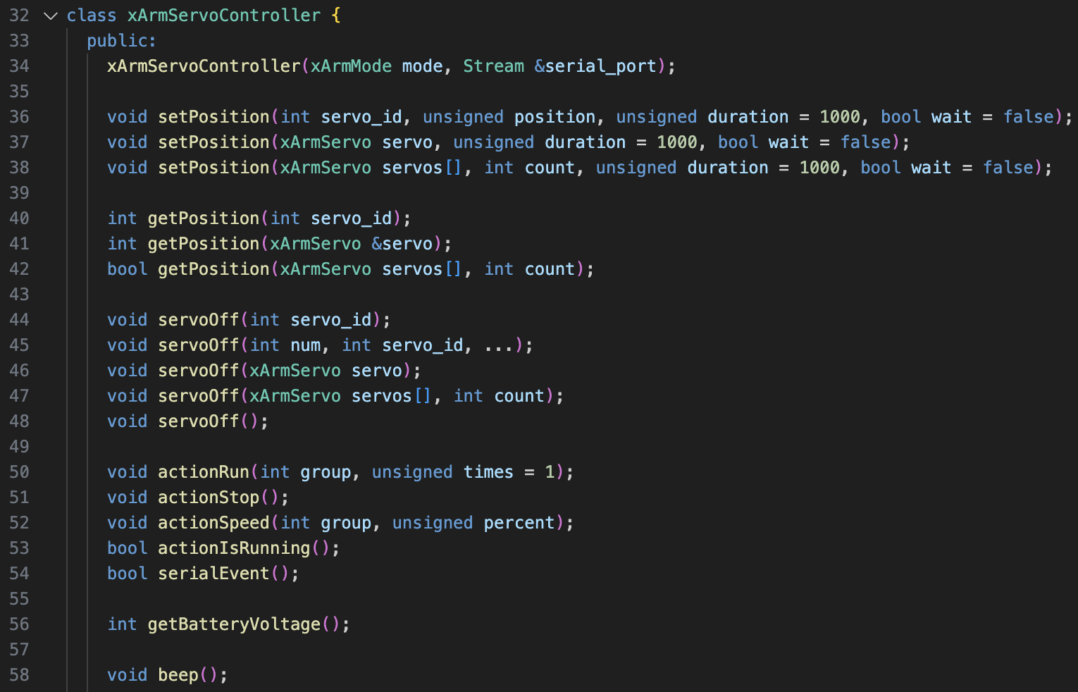
xArmServoController
Library
An overview of the class definition for what we will be using to control the robot - the xArmServoController class.
The main component that we will be using from this library is the setPosition() function.

Slide 20
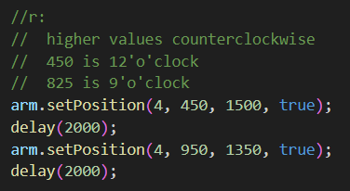
Our Code: Moving the Robot
Servos numbers
The servos each have an individually unique servo Id. They are as follows:
4
5
6
setPosition()
This function is part of the xServoArmController source code, and it takes a servo id, position to set arm to, how fast to move the arm, and a bool for if it should wait.
Notes:
8-21

Slide 21
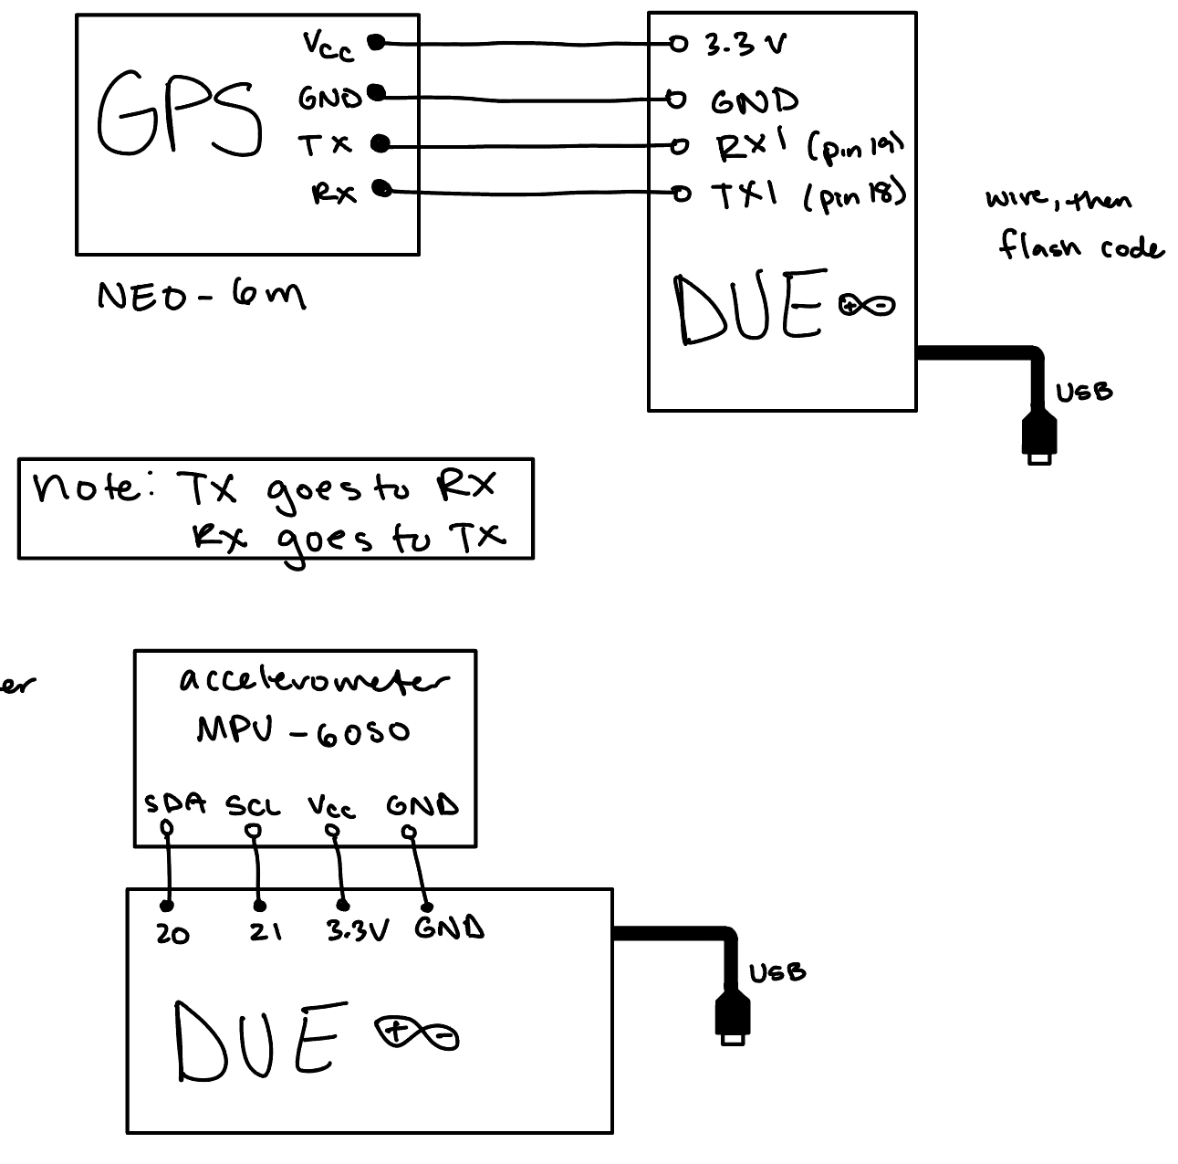
Wiring Diagrams
For GPS and Accelerometer
Directly into an Arduino board

Slide 22
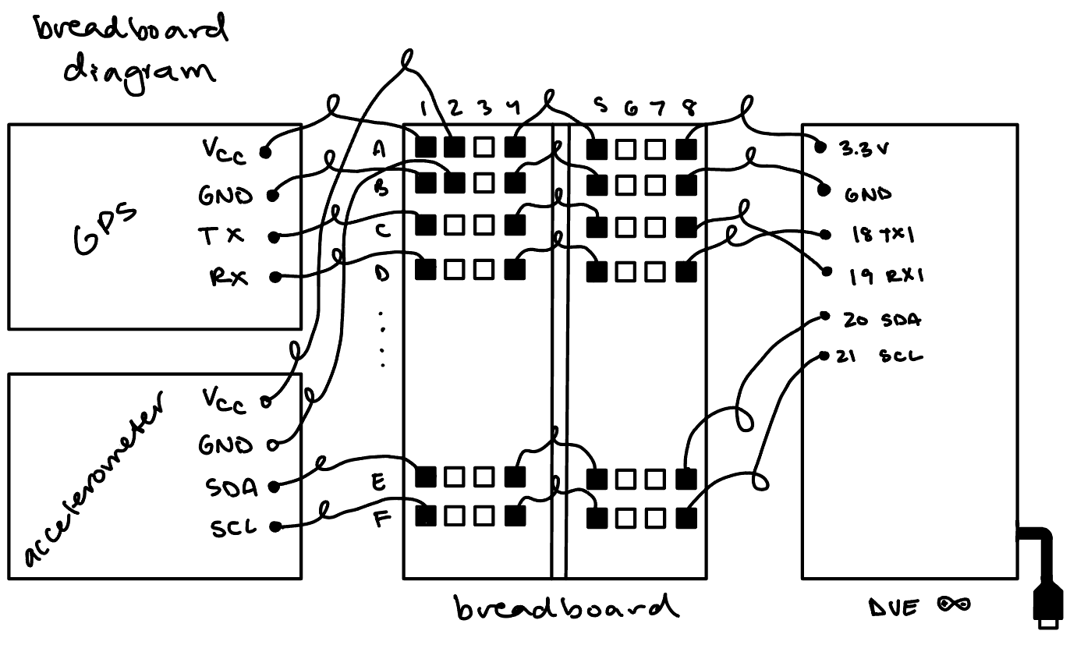
Wiring Diagrams
For GPS and Accelerometer
Using a breadboard

Slide 23
Validation Approach (DVP)
Requirement
Test
Weight
Weigh Devices, devices shall not exceed 10 lbs
Code compiles and runs
Compile code and flash to board
Connection at 6 feet
Set devices 6 feet apart and run program
Connection from 45 degrees
Rotate receiver 45 degrees off-axis and run program
Connection from 90 degrees
Rotate receiver 90 degrees off-axis and run program
Connection from 180 degrees
Rotate receiver 180 degrees off-axis and run program
Notes:
24 onwards, spencer

Slide 24

Manufacturing Plan
Very few things need to be assembled, most purchased as-is via Amazon.
Connecting wires together, soldered a couple wires to solve connectivity issues.
Robot provided was assembled by client.
Total unit cost would be around $100, including the board but not robot.
Notes:
An overview of the Manufacturing plan for each component/assembly including:
i. Make vs. Buy analysis
ii. Sourcing of components or raw materials
amazon
iii. Location (or process) for manufacturing
Locally Done by hansen photonics
iv. Who is responsible for fabricating each component (with approx. timing)?
v. Estimated cost of each components/fabrication and a total cost roll-up.
50$ Arduino board + 37$ + 5$ connectors

Slide 25
Project Schedule
Oct
Nov
Dec
Jan/Feb
Feb/Mar
Mar - May
Developing a plan
Testing of previous work
Development of code
Implementation
Feedback and Adjustments
Project Close
Sourcing documents vital to project:
Project Plan (DVP, Budget, Project Schedule)
Acquiring and testing of previous designs and code.
Starting code design process for our algorithm.
Developing the code necessary to carry out tasks.
Installing all the new parts, getting the code to compile and run properly.
Sharing our work with our client, receiving feedback for final changes.
Finishing out the project with final documents and presentations.
‹#›

Slide 26
Budget/Bill of Materials
04
04
01 GPS Modules
04 Connectors
Estimated Amount: $100
Actual: $18.99
03
Estimated Amount: $50
Actual: $0
01
03
01
02 Accelerometers
03 Possible Arduino Board
02
Estimated Amount: $100
Actual: $9.99
Estimated Amount: $50
Actual: $0
Total Budget: $300 Total Actual Spent: $36.65

Slide 27
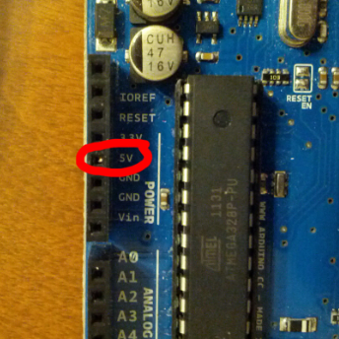

Risks
Failure of parts
Issues with arduino boards
Possible faulty components
Parts easily break
Bugs in code
Not behaving as expected
Hardware Inexperience
Wiring
Micro-controllers
Data issues and mishandling
Different potential setups we can have
Weather Issues

Slide 28
Physical Demonstration

Slide 29
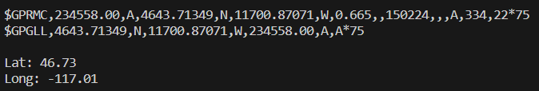
GPS Data Output
Raw sentences sent, parsed by TinyGPS
Note the degrees/minutes difference
Future Plans: also get orientation data

Slide 30
Robot Movement
Autonomous movement of the robot.
Future plans:
Using this autonomous movement in tandem with positional data.

